Slide 1



y
Secure Data Infrastructure on the Cloud for Population Informatics
Hye-Chung Kum
Associate Professor
Department of Health Policy and Management, School of Public Health
Department of Computer Science and Engineering
Department of Industrial and Systems Engineering
The Center for Remote Health Technologies and Systems (CRHTS)
Texas A&M University
kum@tamu.edu
Population Informatics Research Group
http://pinformatics.org
Notes:
Hi, my name is Hye-chung.

Slide 2
Agenda
What is Population Informatics ?
Secure Data Infrastructure on the Cloud
Social Genome ViDaL (Virtual Data Library)

Slide 3
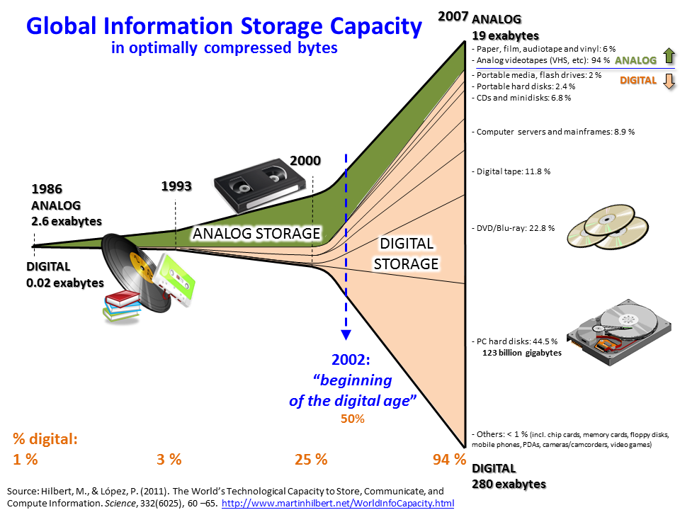

Slide 4
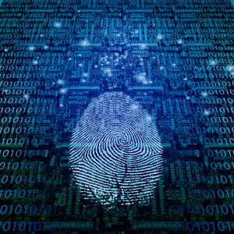
The Digital Society (~2002)
Most everything we do are recorded digitally

Slide 5
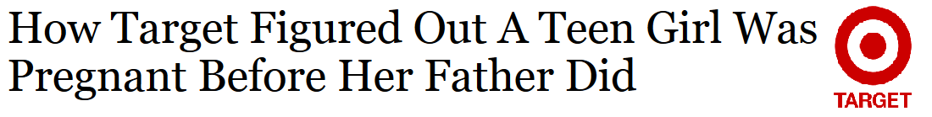
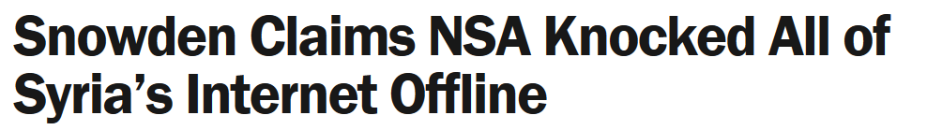
The Cost of the Digital Society
There is no turning back !
Personal information is already being used
Marketing: Target
Campaigning
Intelligence: Edward Snowden
Notes:
there is NO turning back…this is a digital world, and the information is out there… personal information is already being used for undesirable purposes with no transparency or control. We have already paid the cost of the digital society. Target and NSA know about you.
Target 2012

Slide 6
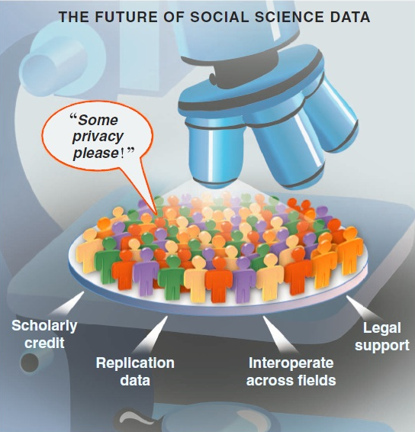
Why not reap the benefits too ? Population Informatics
Game changing research
Transform health and social sciences
Major impact on public policy, public health, resource management
Social genome data can tell us about how people live, work, respond to change, make decisions, and most importantly the collective impact of these individual decisions.
Such insights help us understand the root causes of social and public health problems, predict the downstream effects of different policy options, and allocate our collective resources for the greatest impact.
Easier and safer access to better data & tools
Improved security of sensitive data
Improved integration of data
Reasonable cost
Source: Gary King. Ensuring the Data-Rich Future of the Social Sciences, Science, vol 331, 2011, pp 719-721.
Notes:
Population informatics is the burgeoning field at the intersection of social sciences, health sciences, computer science, and statistics that applies quantitative methods and computational tools to answer questions about human populations.
Social genome data can tell us about how people live, work, respond to change, and make decisions, and most importantly the collective impact of these individual decisions. Such insights help us understand the root causes of social and public health problems, predict the downstream effects of different policy options, and allocate our collective resources for the greatest impact.
Just as bioinformatics has revolutionized biological research, population informatics could catalyze significant advances in our understanding of trends in society, health, and human behavior.
Never before in history have we had more data to use for population research, however, privacy and confidentiality protection is critical to the success of population informatics research.
--------------------

Slide 7
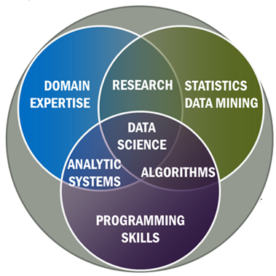

Bioinformatics Apply Data Science to Human Genome Data
Biology
Human
Genome
Data
+

Slide 8
Population informatics Apply Data Science to Social Genome Data
Studies of society (groups of people)
Social sciences
Health sciences (population health)
Social Genome
Data
+

Slide 9
How do we reap the benefits too ?
Overarching question:
How can we use the abundance of existing digital data about people, aka big data, (e.g. government administrative data, electronic health records)

Slide 10
How do we reap the benefits too ?
Overarching question:
How can we use the abundance of existing digital data about people, aka big data, (e.g. government administrative data, electronic health records)
to support accurate evidence based decisions for policy, management, legislation, evaluation, and research

Slide 11
How do we reap the benefits too ?
Overarching question:
How can we use the abundance of existing digital data about people, aka big data, (e.g. government administrative data, electronic health records)
to support accurate evidence based decisions for policy, management, legislation, evaluation, and research
while protecting the confidentiality of individual subjects of the data?

Slide 12
Actionable
Policy and Practice
Data Savvy
Managers
(Decision Makers)
Data Based Answers to
Real world Problems
Transformational Knowledge
Secure Federated Data Infrastructure
Federated administrative data, Linkable survey microdata
Other (Blog, Private company data, etc.)
Information
Broad new research questions
Data Intensive
Domain Scientists
Frame Real World Questions
to Tractable Questions
Domain Knowledgeable
Computer Scientists
Methods
Datamining & Statistical methods
Social Genome Data Library
Population Informatics: The systematic study of populations via secondary analysis of massive data collections (“big data”) about people.
Kum, H.C., Krishnamurthy A., Machanavajjhala A., and Ahalt S. Social Genome: Putting Big Data to Work for Population Informatics. IEEE Computer Special Outlook Issue. pp 56-63. Jan 2014

Slide 13
Case Studies

Slide 14
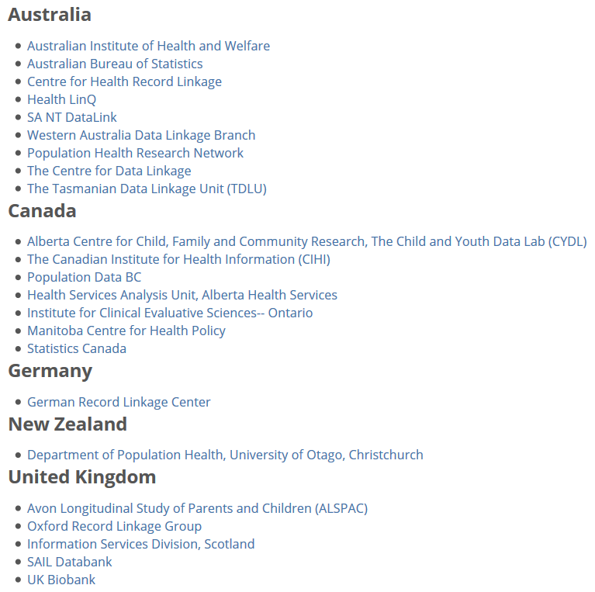
Regional Record Linkage Centers Population Data Linkage Network
Notes:
James Farrow: SA NT

Slide 15
LEHD: US Census Bureau
Vertically integrated in one domain
Wage : UI (Unemployment Insurance) Data
Decision support : LEHD website
By building an integrated data that “permits the real world of the US economy to be interrogated by the models of unemployment dynamics” Peter Diamond, Dale Mortense, and Christopher Pissarides shared the Nobel Prize in economics 2010 (David Warsh, economicprinciple.com)

Slide 16
Cancer care among the poor
Linked the New York central cancer registry with Medicaid enrollment and claims files to assess cancer care among the poor
Yung RL, Chen K, Abel GA, et al. Cancer disparities in the context of Medicaid insurance: a comparison of survival for acute myeloid leukemia and Hodgkin's lymphoma by Medicaid enrollment. Oncologist 2011;16(8):1082-91

Slide 17
The Problem Why not research?
Higher privacy standard and accountability
Difficult to access: Privacy/confidentiality
No neutral safe place to put it together
Requires more accurate results compared to recommending books
Error management
Lack Data management tools and expertise
Difficult to integrate: silo/scattered data
Difficult to clean data
Notes:
Research is and should be held to a higher ethical standard.
It also requires more accurate results than is acceptable when recommending books.
So far, challenges associated with maintaining privacy and confidentiality, data access, integration, and management and error management have constrained the use of person-level data in these areas of research, leaving rich databases largely untapped.

Slide 18
Running the Social Genome ViDaL (Virtual Data Library)
How do we handle person level data
for research well ?

Slide 19
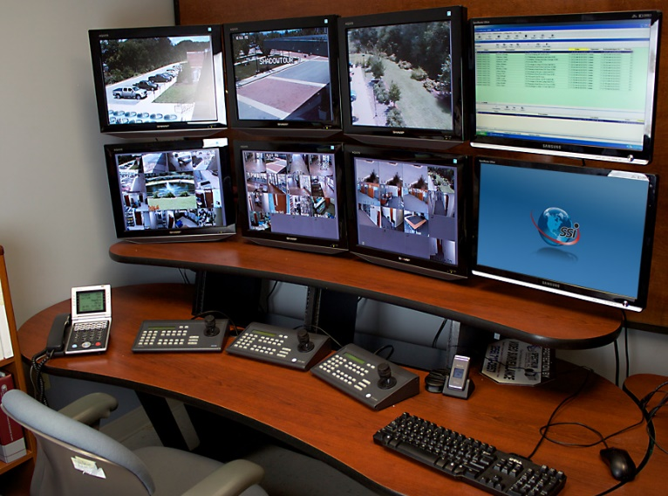

Information Privacy Take Away I Information Accountability Works
Secrecy : Hiding information
In reality, has limited power to protect privacy
Severe Consequences related to
Accuracy of data and decisions, use of data for
legitimate reasons, transparency & democracy
Information Accountability (Credit Report)
Very clear transparency in the use of the data
Disclosure : Declared in writing, so when something goes wrong the right people are held accountable (data use agreements)
IT WORKS! Primary method used to protect financial data
Internet : crowdsourced auditing (public access IRB)
Logs & audits : what to log, how to keep tamperproof log
D.J. Weitzner et al., Information Accountability, Comm. ACM, vol. 51, no. 6, 2008, pp. 82–87.
Notes:
First, information accountability is effective in privacy protection!
Although secrecy (limiting access) seems the instinctive method for best protection, in practice, secrecy has limited power for real protection. And yet it has severe consequences related to the accuracy of data and decisions, cost of use for legitimate purposes, as well as transparency and democracy. Many of us have experienced the difficulty of correcting a careless data entry error that has a taken weeks to fix.
In contrast, the financial sector has long been able to provide high level of protection on personal financial data, one of the most private information targeted by the most malicious cybercrimes today. Our credit history is our financial social genome which is well protected with a combination of technology and governance via information accountability.
Just as the financial sector has succeeded in providing protection through the use of secure computer software, the building of a safe environment, and increased governance and monitoring of how the data is collected and used, when social genome data libraries can take a similar approach these projects could facilitate the growth of population informatics as a revolutionary research tool to benefit our society

Slide 20

Information Privacy Take Away II Privacy is a BUDGET constrained problem
Differential Privacy proves each query leads to some privacy loss while providing some utility in terms of data analysis
Background knowledge attack is difficult to protect against
“local privacy”: my neighbor works at the hospital
The goal is to achieve the maximum utility under a fixed privacy budget
Approaches to Privacy Protection (slide)
Utility Privacy
Notes:
Second, it is important to understand that information privacy is a budget constrained problem as proven mathematically by privacy experts …that privacy and use of the data MUST be balanced.
The goal is to achieve the maximum utility under a fixed privacy budget. You can not assume unlimited privacy in the real world.

Slide 21
Social Issues: Balance between
Individual privacy
Secrecy does not work very well : accuracy of data
Cost of integrity of data
Bias in research: selective sampling
Incorrect analysis that can lead to wrong decisions
Organization transparency & accountability
Freedom of speech
Marketing is freedom to express why one should prescribe certain drugs
Marketing is freedom to send junk mail & call
Thus, getting more information to better target is acceptable and should be allowed

Slide 22
Information Privacy Take Away III Privacy as contextual integrity (legal)
Helen Nissenbaum (NYU Law School)
Washington Law Review, Vol. 79, No. 1, 2004
a conceptual framework for understanding privacy expectations and their implications developed in the literature on law, public policy, and political philosophy
Privacy Protection / Violation
Social norms of expectation (on use, sharing etc)
Due diligence
Quantifying harm : loss of job

Slide 23
Privacy Expectation for Doing Research
Consider the RISK of HARM versus BENEFIT to SOCIETY
Taking into account the COST
Individual privacy
Cost of integrity of data : bad data can lead to wrong decisions
Lost opportunity cost of no access to data
Organization transparency & accountability (democracy)
Value gained through obtaining timely, accurate, appropriate information for good decision making
Financial cost of data security measures
Transparent and accountable use of data
Notes:
Finally, personal big data is freely used for many undesirable purposes today. We should distinguish between using big data for research and these other purposes. The use of personal big data for research needs to consider the actual risk of harm, benefit to society, as well as the huge lost opportunity cost of not using big data for research.
We can do this the right way with control and accountability, just as we do in the credit report system
... by making the use of data very transparent.
It is time to reap the benefits of big data by conducting research with it for the greatest social benefit.

Slide 24
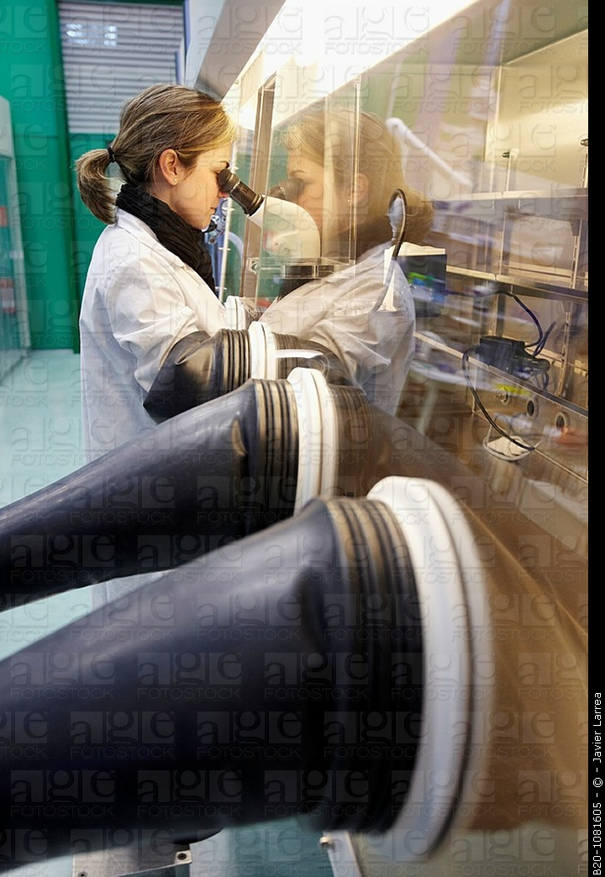
Privacy-by-Design
A different perspective on privacy and research using personal data
Personal Data is Delicate/Hazardous/Valuable
Important to have proper systems in place that give protection but allow for continued research in a safe manner
All hazardous material need standards
Safe environments to handle them in : closed computer server system lab
Proper handling procedures : what software are allowed to run on the data
Safe containers to store them : DB system

Slide 25
Design Principles
First, the Minimum Necessary Standard states that maximum privacy protection is provided when the minimum information needed for the task is accessed at any given time.
Second, the Maximum Usability Principle states that data are most usable when access to the data is least restrictive (i.e. direct remote access is most usable).
Based on common activities in the workflow, design systems that have maximum access to the minimum amount of information required
Combination of technology, governance, and transparency (operation)

Slide 26
WORKFLOW
Safe Platform for
Data to Decision

Slide 27
System of Access Models
Protection Usability
Restricted Controlled Monitored Open
Data Analysis Type I Analysis Type II Publish
Preparation (More sensitive data) (Less sensitive data)
More Protection More Usability
Raw Data Decision
Goal: To design an information system that can enforce the varied continuum from one end to the other such that one can balance privacy and usability as needed to turn data into decisions for a given task

Slide 28
The start …
Write up a research plan on
What data you need
What you want to do with them
Determine access levels for each data
Submit to IRB process

Slide 29
IRB: Risk of privacy violation vs. Benefit to Society
Risk of attribute disclosure
Group disclosure
Linkage attack using auxiliary information
Risk of identity disclosure
Given?
Kinds of data elements used in the study
Name/dob/cancer status/ etc… (are there $$)
What system the data resides in : HW/SW
Risk of outsiders intruding / insider attack / negligence
What can users do with the data on the system
Take data off / look at everything / only do limited queries

Slide 30

Restricted Access : Prepare the customized data
Decoupled Data (Kum 2012)
Automated Honest Broker SW
Sample selection
Attribute selection
Data integration (access to PII)
Some data cleaning
Full IRB
Example: RDC (TX census RDC)
Notes:
Need access to LOTS of data, often times include PII to prep
High risk to privacy

Slide 31
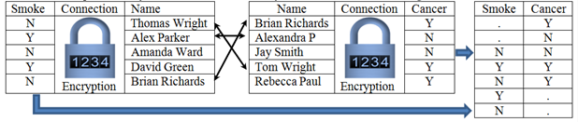
Privacy Preserving Interactive Record Linkage
Decouple data via encryption
Automated honest broker approach via computerized third party model
Chaffe to prevent group disclosure
Kum, H.C., Krishnamurthy A., Machanavajjhala A., Reiter M., and Ahalt S. Privacy Preserving Interactive Record Linkage (PPIRL). J Am Med Inform. Assoc. 2014;21:212–220. doi:10.1136/amiajno-2013-002165

Slide 32
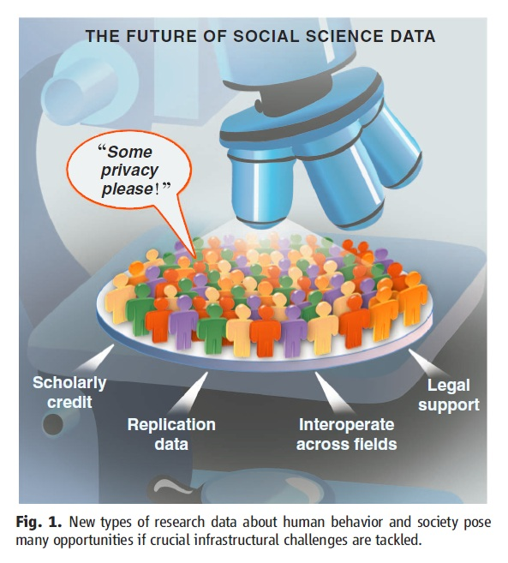
Controlled Access : Model using given tools
With approved deidentified data
Locked down VM: customized appliances
only approved software
Remote access via VPN
Very effective for threats from HBC
Full IRB
U Chicago-NORC , UNC-Tracs (CTSA), UCSD-iDASH, SAIL
Gary King. Ensuring the Data-Rich Future of the Social Sciences, Science, vol 331, 2011, pp 719-721.
Notes:
Delicate species (live, change and move as you observe), requires special handling, container (DBS) and environment (lab)

Slide 33
Monitored Access : Freely Repurpose
Information Accountability model
Exempt IRB: Explicit data use agreement (5 big Q)
Public online (crowdsource)
Any software & auxiliary data
Remote Access via VPN
Less sensitive data (e.g. Aggregate data)
SHRINE, Secure Unix servers
Gary King. Ensuring the Data-Rich Future of the Social Sciences, Science, vol 331, 2011, pp 719-721.
Notes:
Delicate species (live, change and move as you observe), requires special handling, container (DBS) and environment (lab)

Slide 34
Open Access : No restriction on use
Anyone : Publish information for others
No IRB
No monitoring use
Publish data use terms
Disclosure Limitation Methods (filter)
Be careful of incorrect use
Sanitized data
Public websites, publications
Package with filter (disclosure limitation methods) & take out of lab
Gary King. Ensuring the Data-Rich Future of the Social Sciences, Science, vol 331, 2011, pp 719-721.
Notes:
Delicate species (live, change and move as you observe), requires special handling, container (DBS) and environment (lab)

Slide 35
Privacy Protection Mechanism
Protection Usability
Restricted Controlled Monitored Open
Access | Restricted Access | Controlled Access | Monitored Access | Open Access
Protection Approach | Physical restriction to access | Lock down VM (limit what you can do on the system) | Information accountability | Disclosure Limitation
Monitoring Use | All use on & OFF the computer is monitored | All use on the computer is monitored |  | Trust
IRB | Full IRB approved | Full IRB approved | IRB Exempt (register) | Terms of Use
R1:Crypto-graphic Attack | Very Low Risk | Low Risk. Would have to break into VM | High Risk | NA
R2: Data Leakage | Very Low Risk. Memorize data and take out | Physical data leakage (Take a picture of monitor) | Electronically take data off the system.

Slide 36
Comparison of risk and usability
Protection Usability
Restricted Controlled Monitored Open
 |  | Restricted Access | Controlled Access | Monitored Access | Open Access
Usability | U1.1: Software (SW) | Only preinstalled data integration & tabulation SW. No query capacity | Requested and approved statistical software only | Any software | Any software
 | U1.2: Data | No outside data allowed But PII data | Only preapproved outside data allowed | Any data | Any data
 | U2: Access | No Remote Access | Remote Access | Remote Access | Remote Access
Risk | R1:Crypto-graphic Attack | Very Low Risk | Low Risk. Would have to break into VM. | High Risk | NA
 | R2: Data Leakage | Very Low Risk. Memorize data and take out | Physical data leakage (Take a picture of monitor) | Electronically take data off the system. | NA

Slide 37
Use Published Data for Good Decision Making
Protection Usability
Restricted Controlled Monitored Open
Data Analysis Type I Analysis Type II Publish
Preparation (More sensitive data) (Less sensitive data)
More Protection More Usability
Raw Data Decision
Deployed together the four data access models can provide a comprehensive system for privacy protection, balancing the risk and usability of secondary data in population informatics research

Slide 38
Closing Thoughts
Overarching question: How can we use the abundance of existing digital data, aka big data, (e.g. government administrative data, electronic health records) to support accurate evidence based decisions for policy, management, legislation, evaluation, and research while protecting the confidentiality of individual subjects of the data?
Preferred approaches: Data Science - To build efficient and effective human computer hybrid processes and systems to clean, integrate, and extract actionable information from raw chaotic data and deliver accurate information in a timely secure manner to decision makers (e.g. researchers, policy makers, mangers, clinicians).
Primary data: Social Genome data – person level data, usually identifiable (so we can accurately integrate diverse data) but partitioned data
Primary issues: Privacy (safe data access, code of conduct), data integration, error management,
Velocity, variety, veracity, volume (lots of SMALL datasets)

Slide 39

Population Informatics Research Group
http://pinformatics.org
kum@tamu.edu
Notes:
Hi, my name is Hye-chung.

Slide 40
Building Capacity
For handling person level data
Know information privacy
Know basic IT and security
Know basic legal issues in person level data
Know how to handle/process raw data
Clean, Merge, Transform etc
Know how to build/detect meaningful features to use in modeling
Modeling
Be able to think critically and move between
Real world problem
Data problem

Slide 41
Homework for computer scientists
How can we run a good public social genome library?
Secure data access
Usable system for non computer savvy people (social scientists, statisticians)
“legally” compliant system
Reasonable cost

Slide 42
Knowledge base platform
Goals of the typical ETL process
maintain one clean collection of data for operation
Approach for knowledge base platform
Abstract out domain-independent algorithms into a platform layer
expose a set of plug-ins that different users can customize for knowledge base synthesis.
It is important that such plug-ins can support efficient human decision making by quickly pointing out inconsistencies that need to be resolved in the federated data
along with interactive visualization that supports multiple levels of details. Important to support interaction with data.
K. Bellare et al., “WOO: A Scalable and Multi-Tenant Platform for Continuous Knowledge Base Synthesis,” VLDB Endowment, vol. 6, no. 11, 2013, pp. 1114–1125.

Slide 43
Datawarehouse?
Knowledge base synthesis vs typical ETL (extract-transform-load) tools available for data warehousing
Knowledge base synthesis
from multiple domains
maintain multiple versions of the data
to satisfy the disparate information needs of multiple users (tenant)
Multiple purposes

Slide 44
My research
Computer Science
Privacy Preserving Interactive Record Linkage
Sequential Analysis
Social genome library: Secure cloud computing. Layered access control
Information Privacy
KDD information systems (software engineering, data pipeline)
SBEH (social, behavior, economic, health)
Human subject research (IRB)
Health insurance (Medicaid)
Child welfare
Monthly cash assistance programs (TANF)
Post actuate care
Cancer
Diabetes
Mental Health
History?

Slide 45
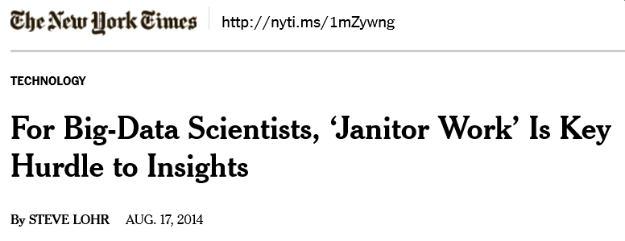
Data Wrangling
Data Wrangling is a term that is applied to activities that make data more usable by changing their form but not their meaning
reformatting data: MDY vs YMD
mapping data from one data model to another: ICD9 vs CPT code
and/or converting data into more consumable forms: to graphs
30-80% of the work in using big data
Once raw data is “wrangled” into the correct analytic data
Running statistics models are fairly simple and similar to what you do traditionally
There are new methods but, usually requires a LOT of data

Slide 46
Data Access

Slide 47
Sorrell v. IMS Health, Inc. : 6 to 3 Privacy of doctor vs right of speech (marketing)
(2011), was a case in which the Supreme Court of the United States held that a Vermont statute that restricted the sale, disclosure, and use of records that revealed the prescribing practices of individual doctors violated the First Amendment.
Prescription Confidentiality Law (2007)
Vermont, Maine, NH + 25 states
Vermont Medical Society resolution stating that using the prescribing history of doctors in marketing was an intrusion into the way doctors practice medicine
Vermont claimed that the law was necessary to protect medical privacy and achieve improved public healthcare
Data mining companies and pharmaceutical manufactures
the law violated their First Amendment rights by restricting the speech of the companies without adequate justification

Slide 48
Population Informatics Challenges
Challenges have constrained the use of person-level data (micro data) in research.
Privacy
Data Access
Error Management and Propagation
Data Management
Data Integration & Cleaning
Notes:
Research is and should be held to a higher ethical standard.
It also requires more accurate results than is acceptable when recommending books.
So far, challenges associated with maintaining privacy and confidentiality, data access, integration, and management and error management have constrained the use of person-level data in these areas of research, leaving rich databases largely untapped.

Slide 49
Actionable
Policy and Practice
Data Savvy
Managers
(Decision Makers)
Data Based Answers to
Real world Problems
Transformational Knowledge
Secure Federated Data Infrastructure
Federated administrative data, Linkable survey microdata
Other (Blog, Private company data, etc.)
Information
Broad new research questions
Data Intensive
Domain Scientists
Frame Real World Questions
to Tractable Questions
Domain Knowledgeable
Computer Scientists
Methods
Datamining & Statistical methods
Social Genome Data Library
Population Informatics: The systematic study of populations via secondary analysis of massive data collections (“big data”) about people.
Kum, H.C., Krishnamurthy A., Machanavajjhala A., and Ahalt S. Social Genome: Putting Big Data to Work for Population Informatics. IEEE Computer Special Outlook Issue. pp 56-63. Jan 2014

Slide 50
More general/common Perspective

Slide 51

The Big Data Problem – Nutshelled Michael Franklin (UC Berkley)
Something’s
gotta
give:
Time
Quality
Money
Massive Diverse and Growing
Data

Slide 52
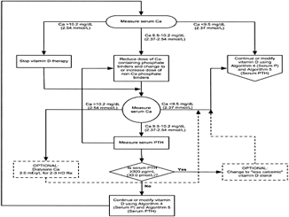
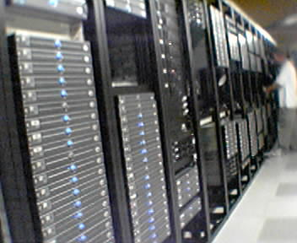

AMPLab: Integrating Three Key Resources
Algorithms
Machine Learning, Statistical Methods
Prediction, Business Intelligence
Machines
Clusters and Clouds
Warehouse Scale Computing
People
Crowdsourcing, Human Computation
Data Scientists, Analysts

Slide 53
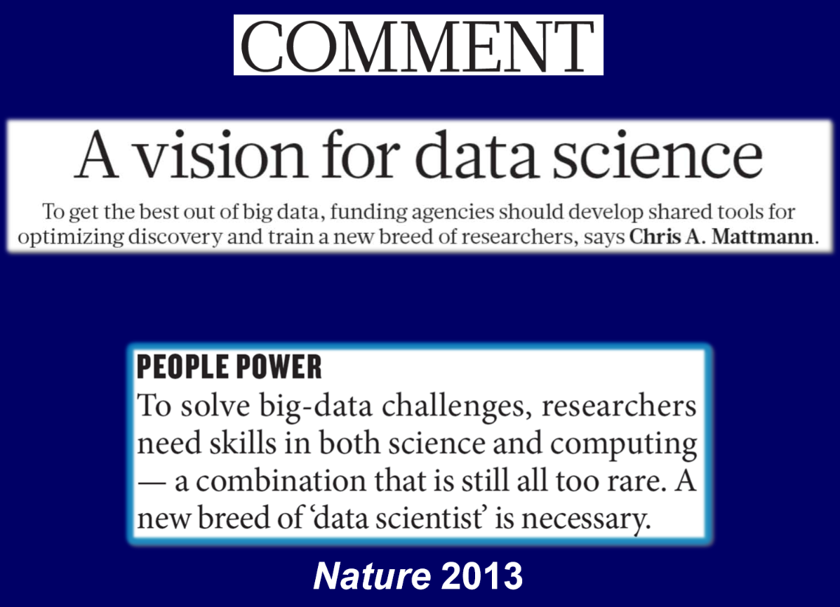
NIH and Biomedical “Big Data” http://acd.od.nih.gov/Big-Data-to-Knowledge-Initiative.pdf

Slide 54
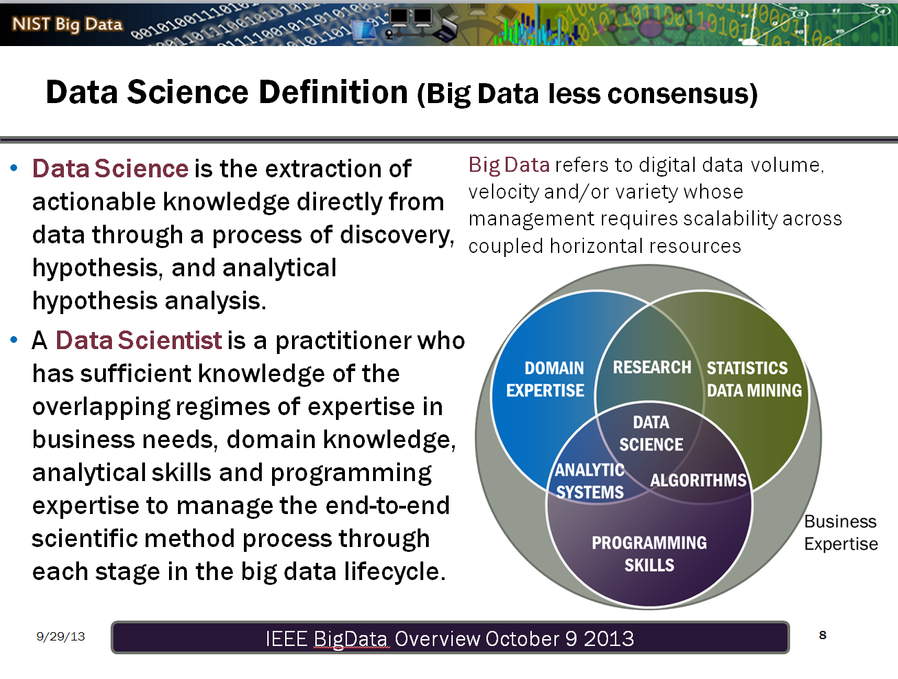

Slide 55
Data Wrangling
Data Wrangling is a term that is applied to activities that make data more usable by changing their form but not their meaning
reformatting data: MDY vs YMD
mapping data from one data model to another: ICD9 vs CPT code
and/or converting data into more consumable forms: to graphs
30-80% of the work in using big data
Once raw data is “wrangled” into the correct analytic data
Running statistics models are fairly simple and similar to what you do traditionally
There are new methods but, usually requires a LOT of data

Slide 56
Thomas Davenport Competing on Analytics
Skill set for good data scientists
IT & Programming skills
Statistical skills
Business skills:
Understand pros/cons of decisions & actions
Communication skills
Excel / PowerPoint
Intense curiosity: the most important skill or trait. “a desire to go beyond the surface of a problem, find the question at its heart, and distill them into a very clear set of hypothesis that can be tested”

Slide 57
Data science teams need people with the skills and curiosity to ask the big questions (oreilly)
Technical expertise: the best data scientists typically have deep expertise in some scientific discipline.
Curiosity: a desire to go beneath the surface and discover and distill a problem down into a very clear set of hypotheses that can be tested.
Storytelling: the ability to use data to tell a story and to be able to communicate it effectively.
Cleverness: the ability to look at a problem in different, creative ways.
Health is a very important domain
Team lead: good questions, good interpretation & implications
http://radar.oreilly.com/2011/09/building-data-science-teams.html

Slide 58
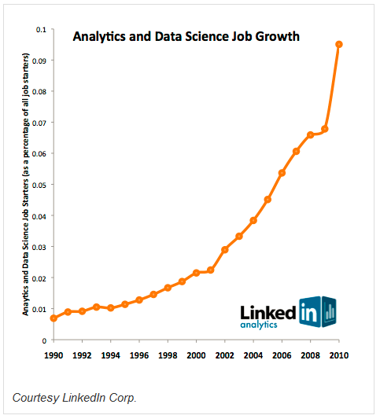
Job market of data scientists
statisticians will be the next sexy job
Google Chief Economist Hal Varian
shortage of 190,000 data scientists by the year 2019
McKinsey Global Institute

Slide 59
New Era in Science : Big Data Science
Data is the new raw material of business: an economic input almost on par with capital and labor.(Microsoft’s Craig Mundie)
Those who can harness the power of data will lead the next century and drive innovation in commerce, scientific discovery, healthcare, finance, energy, government, and countless other fields.
Students who learn to be a data science will be in high demand.

Slide 61
Vocab: Information Privacy
What is information privacy?
Privacy vs confidentiality
don’t ask vs don’t tell
Privacy vs security
PHI: Protected Health Information
PII: Personally Identifiable Information

Slide 62
Vocab: Informed Consent
Opt in
Opt out
Blanket consent

Slide 63
Vocab: Disclosure
Identity disclosure
Attribute disclosure
Harm from disclosure
Identity theft: SSN, Name, DOB
HIV status
Group disclosure
Partial disclosure
Incremental disclosure
Minimum necessary standard
Cost of implementation?

Slide 64
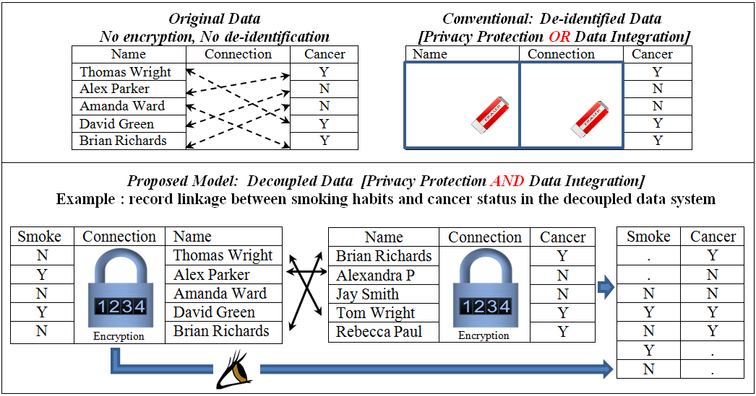
Decoupled Data : Identity disclosure w/o attribute disclosure

Slide 65
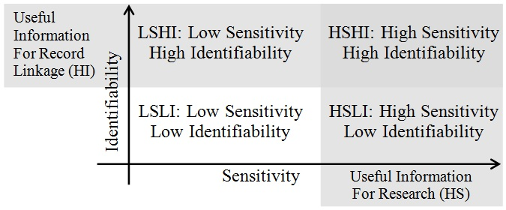
Identifiability and Sensitivity of Information

Slide 66
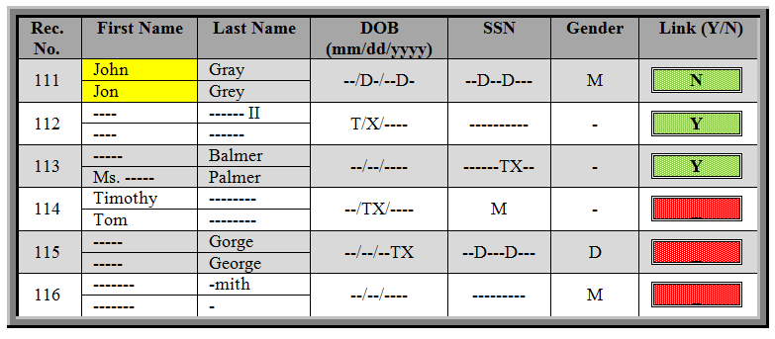
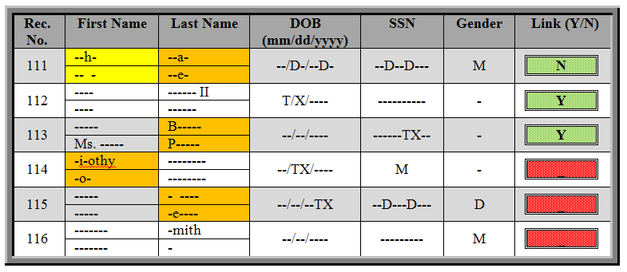
Partial disclosure

Slide 67
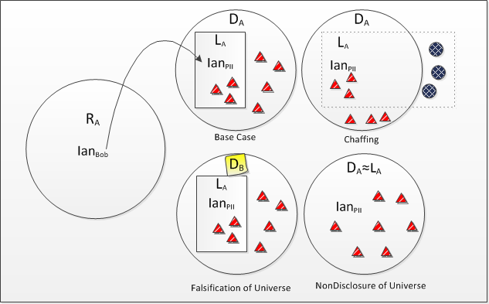
Chaffing & Universe Manipulation Protection against group disclosure

Slide 68
Case Studies

Slide 69
Regional Record Linkage Centers Population Data Linkage Network
Notes:
James Farrow: SA NT

Slide 70
Cancer care among the poor
Linked the New York central cancer registry with Medicaid enrollment and claims files to assess cancer care among the poor
Yung RL, Chen K, Abel GA, et al. Cancer disparities in the context of Medicaid insurance: a comparison of survival for acute myeloid leukemia and Hodgkin's lymphoma by Medicaid enrollment. Oncologist 2011;16(8):1082-91

Slide 71
Tools for data wrangling
Reusable code
SAS macros, stata & R: user defined
Write your own
Download others: Read others and modify
Per data, accumulate custom tools for the data
Keep it organized so you can find it when you need it
Keep it general enough so it can be used more widely
Learn basic
Programming concepts: loops, conditionals, flow diagram
Software Engineering

Slide 72
Human Genome & Bioinformatics

Slide 73
Bioinformatics
The BIG DATA
Human Genome
Transformed how biology is studied
Crucial insights maybe gained that is not possible in other ways
Health of a person
Hypothesis generation
Often confirmed in the lab

Slide 74
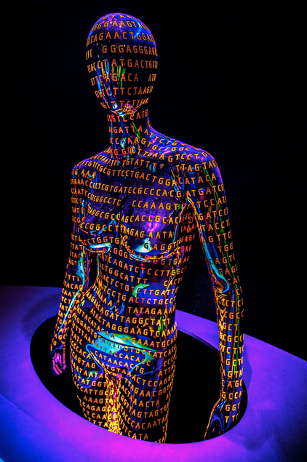
Human Genome
The human genome is the complete set of nucleic acid sequence for humans (Homo sapiens), encoded as DNA within the 23 chromosome pairs in cell nuclei and in a small DNA molecule found within individual mitochondria. Human genomes include both protein-coding DNA genes and noncoding DNA.
(Wikipedia)

Slide 75
4V Properties of BIG DATA Human Genome
Volume : lots of data
Base Paris in Chromosome 1: 249,250,621
The useful information for a particular question is buried in a deluge of “not relevant data”
So big, have to change the algorithm
Velocity : constantly generating & changing
Variety
Variations in Chromosome 1: 4,401,091
There are variations to patterns that need to be considered
Veracity : errors
Also result in variations to patterns that need to be considered
(Value : bioinformatics – transformed biology)
Crucial insights maybe gained about the health of a person that is not possible in other ways

Slide 76
Social Genome & Population Informatics

Slide 77
4V Properties of BIG DATA Social Genome
Volume : lots of data
So big, have to change the algorithm ?
Coherent data? (data integration)
Velocity : constantly generating & changing
Variety : expressed in many ways
Veracity : lots of errors
(Value) : studies of society, groups of people
Social sciences
Health sciences : population health

Slide 78
SDLink: Computerized third party software
Decouple data
Split into two tables
Shuffle & encrypt
Chaffing: add fake data
Incremental as needed information disclosure

Slide 79
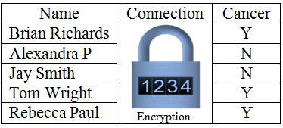
Attribute Disclosure via Group Disclosure
Shuffling & Encryption of connection information
group disclosure: Min / Max income
Everyone on the list must be between min & max

Slide 81
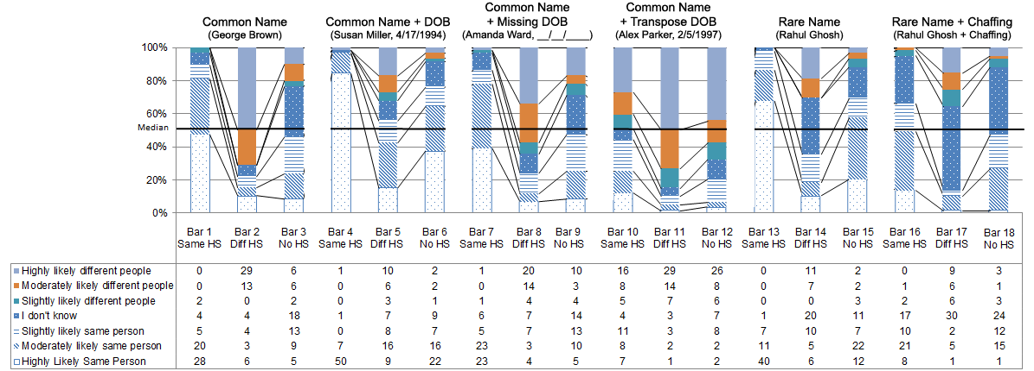
Results

Slide 82
Conclusion
Identity disclosure without sensitive attribute disclosure has little potential for harm.
Chaffing is very effective for rare names
Reduce attribute disclosure risk to lower levels than common names on clean list
Common name + DOB : too much information
What are meaningful differences in DOB ?
Missing and transposition in DOB in data
Introduce uncertainty
May actually help with more accurate linkage if differences are shown

Slide 83
Basics
Privacy vs confidentiality
Privacy vs anonymity
Identity disclosure
Attribute disclosure
Harm from disclore
Privacy vs security
Security: tool
Lock & Key: Encryption
Access control
Maintain dynamic access control list
Granular access control

Slide 84
Information system requirements
Federal Information Security Management Act of 2002 (FISMA)
Integrity : correctness
Cost of incorrect information leading to incorrect decisions
Confidentiality : sharing information
Sharing what information with who for what purposes
Availability : access

Slide 85
Ethical & Controlled Repository Very clear transparency in the use of the data
Riskier Data Safer Data
Protection Usability
Restricted Controlled Monitored Open
Open Access: Summary statistics (open data)
Monitored Access: Register your research plan
Controlled Access: Approval by IRB
Risk of privacy violation vs. benefit to society
Restricted Access: Link data accurately
H.-C. Kum and S. Ahalt, “Privacy by Design: Understanding Data Access Models for Secondary Data,” Am. Medical Informatics Assoc. (AMIA) Clinical Research Informatics Summit, 2013
Notes:
It will have different level of access based on the risk of harm… Safe summary data is provided as open data under open access, while more sensitive data is provided as monitored, controlled, or restricted access depending on the potential for harm in using the data.
For such a vision to become a reality, there must be a shift in our understanding of privacy protection and accountability from using sensitive data for research.

Slide 86
Privacy expectations for doing research
Contextual Integrity
Easier than business, surveillance
Confidential relationship between researcher and subjects of the data
In secondary data analysis no contact
What is the code of conduct?
IRB approvals based on (Belmont Report)
Benefit to society
Risk of harm
To individuals: privacy violation & inaccurate results
To society : inaccurate analysis resulting in wrong decisions
Actual harm?
Background attack : integrating data
Notes:
DR. Ohno Machado

Slide 87
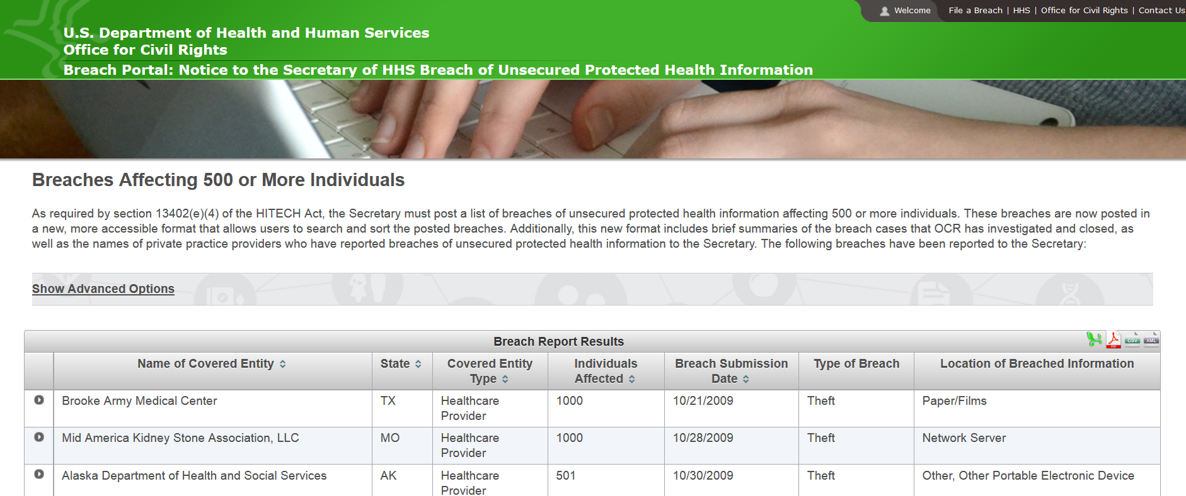
DHHS Hall of Shame

Slide 88
Sorrell v. IMS Health, Inc. : 6 to 3 Privacy of doctor vs right of speech (marketing)
(2011), was a case in which the Supreme Court of the United States held that a Vermont statute that restricted the sale, disclosure, and use of records that revealed the prescribing practices of individual doctors violated the First Amendment.
Prescription Confidentiality Law (2007)
Vermont, Maine, NH + 25 states
Vermont Medical Society resolution stating that using the prescribing history of doctors in marketing was an intrusion into the way doctors practice medicine
Vermont claimed that the law was necessary to protect medical privacy and achieve improved public healthcare
Data mining companies and pharmaceutical manufactures
the law violated their First Amendment rights by restricting the speech of the companies without adequate justification

Slide 89
Voter Registry
Why Voter Registration Data is Available
According to North Carolina law (General Statute 132), "The public records and public information compiled by the agencies of North Carolina Government or its subdivisions are the property of the people. Therefore, it is the policy of this State that the people may obtain copies of their public records and public information free or at minimal cost unless otherwise specifically provided by law." (Voter registration records are not exempt from this law.)

Slide 90
Research Focus
Overarching question: How can we use the abundance of existing digital data, aka big data, (e.g. government administrative data, electronic health records) to support accurate evidence based decisions for policy, management, legislation, evaluation, and research while protecting the confidentiality of individual subjects of the data?
Preferred approaches: Data Science - To build efficient and effective human computer hybrid processes and systems to clean, integrate, and extract actionable information from raw chaotic data and deliver accurate information in a timely secure manner to decision makers (e.g. researchers, policy makers, mangers, clinicians).
Primary data: Person level data, usually identifiable (so we can accurately integrate diverse data) at some point

Slide 91
Research Focus
Overarching question: How can we use the abundance of existing digital data, aka big data, (e.g. government administrative data, electronic health records) to support accurate evidence based decisions for policy, management, legislation, evaluation, and research while protecting the confidentiality of individual subjects of the data? This question focuses on the data science of using massive secondary datasets, a step before the traditional statistical methods can be applied to the data to address specific questions to improve public health.
Preferred approaches: Data Science - To build efficient and effective human computer hybrid processes and systems to clean, integrate, and extract actionable information from raw chaotic data and deliver accurate information in a timely secure manner to decision makers (e.g. researchers, policy makers, mangers, clinicians).
Primary data: Person level data, usually identifiable (so we can accurately integrate diverse data) at some point,
Primary issues: Privacy (safe data access), data integration, error propagation, audits, measurements, modeling
Velocity, variety, veracity, volume (lots of SMALL datasets)

Slide 92
Privacy Preserving Interactive Record Linkage (PPIRL)

Slide 93
NIST Big Data Public Working Group (NBD-PWG)
NIST: National Institute of Standards and Technology (HIPAA security standard)
Leaders of activity
Wo Chang, NIST
Robert Marcus, ET-Strategies
Chaitanya Baru, UC San Diego
http://bigdatawg.nist.gov/home.php

Slide 94
NBD-PWG Subgroups & Co-Chairs
Requirements and Use Cases SG
Geoffrey Fox, Indiana U.; Joe Paiva, VA; Tsegereda Beyene, Cisco
Definitions and Taxonomies SG
Nancy Grady, SAIC; Natasha Balac, SDSC; Eugene Luster, R2AD
Reference Architecture SG
Orit Levin, Microsoft; James Ketner, AT&T; Don Krapohl, Augmented Intelligence
Security and Privacy SG
Arnab Roy, CSA/Fujitsu Nancy Landreville, U. MD Akhil Manchanda, GE
Technology Roadmap SG
Carl Buffington, Vistronix; Dan McClary, Oracle; David Boyd, Data Tactic

Slide 95
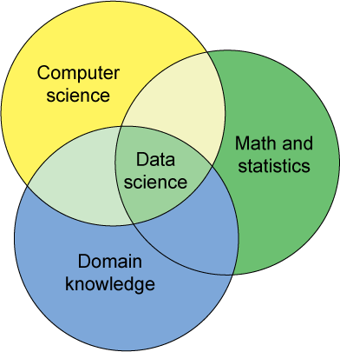
Population Informatics Research Group Data Science Teams
If you are interested in participating on a data science team, watch for opportunities
Certificate in Health Informatics?
6 additional courses

Slide 96
Agenda
What is Big Data ? What is Data Science ?
What is Population Informatics & the Social Genome ?
How is Data Science different from traditional science?
Doing research with Big Data

Slide 97
Inflation: Traditional social science vs Data Science
Consumer Price Index (CPI)
Representative basket of goods and services purchased for consumption by urban households (monthly)
This index value has been calculated every year since 1913
Bureau of Labor Statistics
Billion Prices Project : MIT
The Billion Prices Project is an academic initiative that uses prices collected from hundreds of online retailers around the world on a daily basis to conduct economic research.
Pricing Behavior, Daily Inflation and Asset Prices, Pass-Through (price and exchange rate and international rate), Green Markups (premium for green prod.)

Slide 98
What is the shape of the green line?

Slide 99
Traditional Science : Start with nothing – collect data well

Slide 100
Traditional Science : Start with nothing – collect data well

Slide 101
Data Science : Start with ALL the data

Slide 102

Noise

Slide 103

Data Science: EVERYTHING

Slide 104
First, separate out only the relevant data

Slide 105

Second, clean noise as much as possible

Slide 106
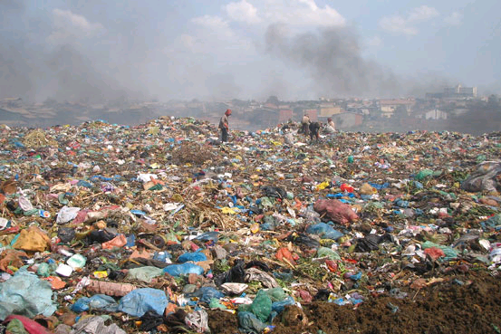


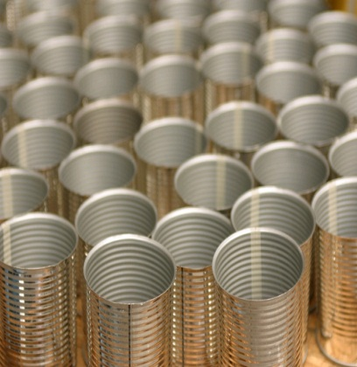

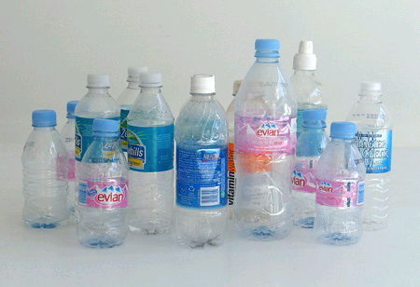
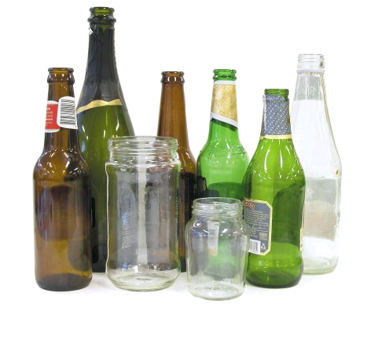
Data Science Knowledge Discovery & Data mining (KDD)
Big Data : impossible to keep organized
KDD
Clean, Merge, Reprocess
Human consumable, valid, novel, potentially useful,
and ultimately understandable information
Analytic dataset

Slide 107
Third: Model

Slide 108
Fourth: Validate to avoid overfitting
Model
Validate

Slide 109
Validation
Training Data
If you have enough data random partition into train/validate/test
If you do not have enough data
Cross validation
Gives confidence to the results when p-value has little meaning
Validate Data
Test Data

Slide 110
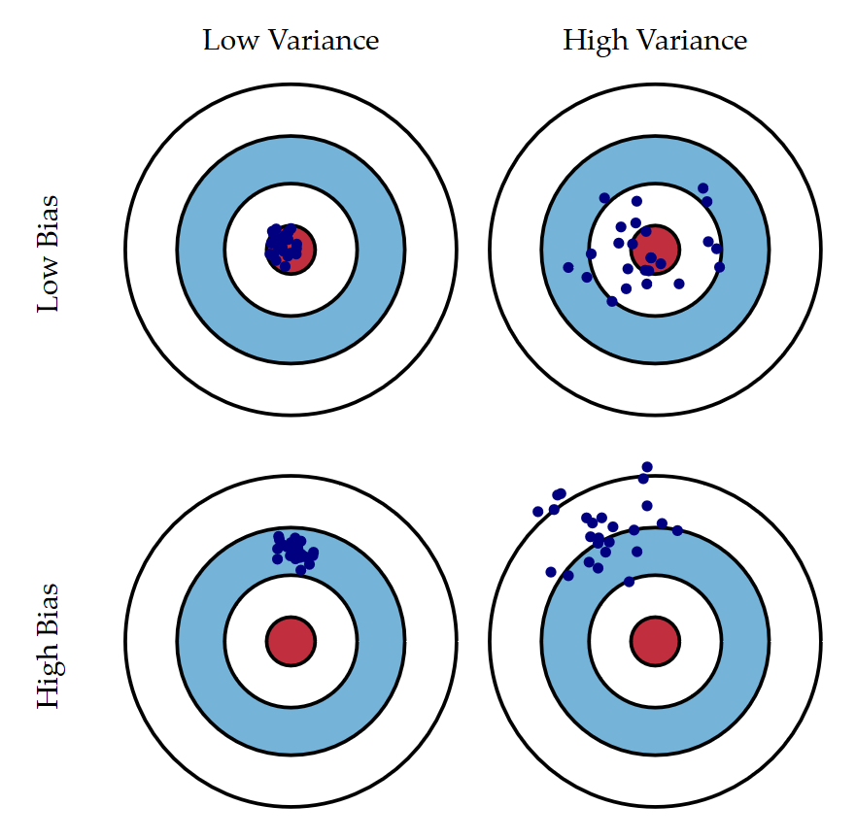
Bias and Variance http://scott.fortmann-roe.com/docs/BiasVariance.html

Slide 111

Validation http://scott.fortmann-roe.com/docs/BiasVariance.html
Under fitting
Over fitting

Slide 112
Sometimes models differ between the two approaches. Why ?
Traditional Science Model
Validated from
Data Science Model

Slide 113
Comparison
 | Traditional Science | Data Science
Common | Use statistics to model from the data points (number of data does matter)
Focus | Usually more about causation | STRONG correlation
Measurement | Mostly Based on theory (deductive) decide what to measure - green only With out seeing the other colors Slow iterative process to discovery | Iterate between deductive (theory based top down) and inductive (data based bottom up) reasoning to figure out what to measure : can see the other colors, so use existing data to compare Different from fishing for results or atheoretical Faster iteration to discovery
Measurement Error | Reduce/minimize by designing experiments well | Know what it is, adjust for it as best as possible. Usually use data that exist
Bias | Random Points, oversampling | Validation is very important: be careful not to over fit to the data, Know the bias
Main issue | Are there enough points to get the full picture? | Is the data clean enough? Is the data representative ? Sensitivity analysis

Slide 114

Take away in Data Science and Statistics
Both are about understanding/developing general models from many data points (variance & bias). The critical part is good measurement.
Notes:
Hi, my name is Hye-chung.

Slide 115
Take away in Data Science and Statistics
Statistics: Hypothesis driven
Data Science: Iterate between deductive (theory based top down) and inductive reasoning (data based bottom up).
MUST validate. Sensitivity analysis is important
Notes:
Hi, my name is Hye-chung.

Slide 116
Take away in Data Science and Statistics
Use data science first to develop analytic data sets from secondary data
Then use statistics to run traditional models (causation) OR
more descriptive models (correlation)
Notes:
Hi, my name is Hye-chung.

Slide 117


Why not reap the benefits too ?
Allocations of resources for education
What is the long term impact of moving to managed care ?
What effect does teacher pay in middle school have on college grades?
The answers could easily be derived from relevant data sets
Notes:
Isn’t it time we reap the benefits from big data as well?
The ability to answer questions about human populations in near real time using distributed datasets that are large, complex, and diverse has the potential to transform social, behavioral, economic, and health sciences.
The results could lead to more informed and effective policy decisions and allocations of public resources.
We can easily derive the answer to broad questions from relevant datasets such as ‘What is the long term impact of moving to managed care?’ or What effect does teacher pay in middle school have on college grades?
But it has to be done in the right way.

Slide 118
Case Study
Work flow | Data Preparation (Data Integration and Selection) |  | Analysis of Micro (Person Level) Data
System | Conventional System | Proposed System | Conventional System | Proposed System
Model | Indirect Access via Health Dept. | Direct Restricted Access | Monitored Access | Controlled Access
Access | No direct access to data | Direct access to data | Remote direct access for authorized users
Type of Data | Multiple Identifiable Microdata Tables | Multiple Decoupled Microdata Tables | De-identified integrated microdata | De-identified integrated microdata with P(linkage)

Slide 119
Analysis of Risk and Usability
Data Preparation (Data Integration and Selection) | Analysis of Micro (Person Level) Data
Reduce risk significantly from insider attack by decoupling PII from the sensitive data | Reduce risk significantly from insider attack and malware in the proposed model by restricting activities on the VM, and running the VM in isolation from the host OS
increase data usability directly carry out record linkage data (attribute and sample) selection | increase data usability leading to more accurate analysis by propagating the error, probability of linkage, to the analysis phase.

Slide 120
Thank you! Questions?
Population Informatics Research Group
http://pinformatics.web.unc.edu/

Slide 121
AMIA: Population Informatics
Public Health Informatics is the application of informatics in areas of public health, including surveillance, reporting, and health promotion. Public health informatics, and its corollary, population informatics, are concerned with groups rather than individuals. Public health is extremely broad ... etc …
Population Informatics
Public Health Informatics
(Population
Health Informatics)
concerned with groups rather than individuals
Population Research
in Demography
(e.g. migration
patterns)
in Economics
(e.g. employment
patterns)

Slide 122
AMIA: Population Informatics
Public Health Informatics is the application of informatics in areas of public health, including surveillance, reporting, and health promotion. Public health informatics, and its corollary, population informatics, are concerned with groups rather than individuals. Public health is extremely broad ... etc …
Population Informatics
Public Health Informatics
(Population
Health Informatics)
concerned with groups rather than individuals
Population Research
in Demography
(e.g. migration
patterns)
in Economics
(e.g. employment
patterns)

Slide 123
The Social Genome Data Library Privacy platform for doing safe research
Personal Data is
Delicate/Hazardous/Valuable
Important to have proper systems in place that give protection (opt out)
But allow for continued research in a safe manner (deidentified when possible)
All hazardous material need standards
Safe environments to handle them in : closed computer server system lab
Proper handling procedures : what software are allowed to run on the data
Safe containers to store them : DB system
Notes:
My vision entails the creation of several region-based facilities, The Social Genome Data Library, that will conduct population informatics the safe way.
It will provide researchers with a safe and secure platform, with opt out mechanisms,
where they can develop, integrate, manage and pursue fundamental questions on our social well being

Slide 124
Ethical & Controlled Repository Very clear transparency in the use of the data
Riskier Data Safer Data
Protection Usability
Restricted Controlled Monitored Open
Open Access: Summary statistics (open data)
Monitored Access: Register your research plan
Controlled Access: Approval by IRB
Risk of privacy violation vs. benefit to society
Restricted Access: Link data accurately
Notes:
It will have different level of access based on the risk of harm… Safe summary data is provided as open data under open access, while more sensitive data is provided as monitored, controlled, or restricted access depending on the potential for harm in using the data.
For such a vision to become a reality, there must be a shift in our understanding of privacy protection and accountability from using sensitive data for research.

Slide 125
Computer Science Perspective

Slide 126
Data Science Knowledge Discovery & Data mining (KDD)
Big Data : impossible to keep organized
KDD
Clean, Merge, Reprocess
Human consumable, valid, novel, potentially useful,
and ultimately understandable information
Notes:
SIGKDD 1998

Slide 127
How different from traditional field of Database?
Traditional field DB
Initially focused on transaction DB systems to OPERATE using digital data
Recoverability, fault tolerance, trace back
E.g.: Operate a company, bank, government agency
KDD, Data Science
Now that we have all this data, how can be best use it for multiple purposes beyond initial operation?
Building a knowledge base platform
Uncertainty (error) management
Timely, accurate enough data management & analysis
Data integration (usually much bigger than one operational transaction DB), Data curation, Data discovery
Data/information/knowledge chain

Slide 128
Rank | Conferences | Field Rating | Pubs | Cita tions | Cita tions/ Pub
1 | KDD - Knowledge Discovery and Data Mining | 73 | 1212 | 22773 | 18.8
2 | ICDE – Int’l Conference on Data Engineering | 65 | 2370 | 23316 | 9.8
3-4 | CIKM - International Conference on Information and Knowledge Management | 43 | 1840 | 11558 | 6.3
3-4 | ICDM - IEEE Int’l Conference on Data Mining | 43 | 2241 | 11368 | 5.1
5 | SDM - SIAM Int’l Conference on Data Mining | 39 | 611 | 6701 | 11.0
6 | PKDD - Principles of Data Mining and Knowledge Discovery | 27 | 634 | 3719 | 5.9
7 | PAKDD - Pacific-Asia Conference on Knowledge Discovery and Data Mining | 23 | 929 | 3106 | 3.3
8 | WSDM - Web Search and Data Mining | 19 | 195 | 1482 | 7.6
9-10 | DASFAA - Database Systems for Advanced Applications | 18 | 868 | 2297 | 2.6
9-10 | ICWSM - International Conference on Weblogs and Social Media | 18 | 223 | 997 | 4.5
KDnuggets
http://www.kdnuggets.com/2013/11/top-conferences-data-mining-data-science.html

Slide 129
Other related fields
IEEE big data conference
Information Science (ontology, data curation)
HCI (CHI): Human computer Interaction
Machine Learning/AI
NLP
Bioinformatics: genomic data
Medical Informatics
American Medical Informatics Association
Spring AMIA (SF)
Fall annual symposium AMIA
vendors
Journal AMIA
Information Science
Electrical Engineering
Computer Science

Slide 130
NIST Big Data Public Working Group (NBD-PWG)
NIST: National Institute of Standards and Technology (HIPAA security standard)
Leaders of activity
Wo Chang, NIST
Robert Marcus, ET-Strategies
Chaitanya Baru, UC San Diego
http://bigdatawg.nist.gov/home.php

Slide 131
NBD-PWG Subgroups & Co-Chairs
Requirements and Use Cases SG
Geoffrey Fox, Indiana U.; Joe Paiva, VA; Tsegereda Beyene, Cisco
Definitions and Taxonomies SG
Nancy Grady, SAIC; Natasha Balac, SDSC; Eugene Luster, R2AD
Reference Architecture SG
Orit Levin, Microsoft; James Ketner, AT&T; Don Krapohl, Augmented Intelligence
Security and Privacy SG
Arnab Roy, CSA/Fujitsu Nancy Landreville, U. MD Akhil Manchanda, GE
Technology Roadmap SG
Carl Buffington, Vistronix; Dan McClary, Oracle; David Boyd, Data Tactic

Slide 132
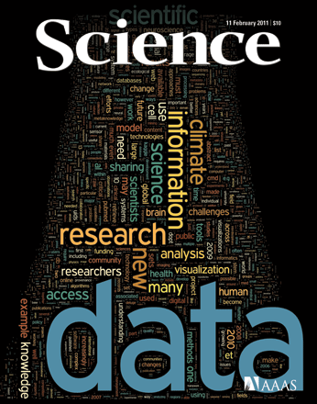
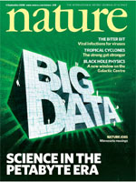
High International Interest Doing Good Research with Big Data
Figuring how to do good research with Big Data
EUDAT (Oct 2011): EU
€16-million initiative to develop an international data management infrastructure over 3 years
White house (Mar 2012) : US
a national effort to fund Big Data research across the federal agencies including NSF, NIH, DOD (Dept of Defense), and DOE (Dept of Energy)
Notes:
Sci : 2011, nature 2008 sep

Slide 133
Notes:
Hi, my name is Hye-chung.

Slide 134
Social Genome ?
Today, nearly all of our activities from birth until death leave digital traces in large databases.
Together, these digital traces collectively capture the footprints of our society, our social genome
Like the human genome, the social genome data has much buried in the massive almost chaotic data
If properly analyzed and interpreted, this social genome could offer crucial insights into many of the most challenging problems facing our society (i.e. affordable and accessible quality healthcare, economics, education, employment, and welfare)
Notes:
Public health informatics=population informatics

Slide 135
Population Informatics Challenges
Challenges have constrained the use of person-level data (micro data) in research.
Privacy
Data Access
Error Management and Propagation
Data Management
Data Integration & Cleaning
Notes:
Research is and should be held to a higher ethical standard.
It also requires more accurate results than is acceptable when recommending books.
So far, challenges associated with maintaining privacy and confidentiality, data access, integration, and management and error management have constrained the use of person-level data in these areas of research, leaving rich databases largely untapped.

Slide 136
Regional Record Linkage Centers Population Data Linkage Network
Australia:
Western Australia :1990’s
C.W. Kelman, J. Bass, D. Holman: “Research use of linked health data – A best practice protocol”, Aust NZ Journal of Public Health 26, 251–255, 2002
Canada
UK
US
Utah
Notes:
James Farrow: SA NT

Slide 137
NIH: Big Data to Knowledge (BD2K)
http://bd2k.nih.gov/
NIH Names Dr. Philip E. Bourne First Associate Director for Data Science
December 9, 2013
NIH commits $24 million annually for Big Data Centers of Excellence
July 22, 2013
Bioinformatics – DNA/RNA data
http://grants.nih.gov/grants/guide/rfa-files/RFA-HG-14-020.html

Slide 138
NIH Definition
The term 'Big Data' is meant to capture the opportunities and challenges facing all biomedical researchers in accessing, managing, analyzing, and integrating datasets of diverse data types [e.g., imaging, phenotypic, molecular (including various '–omics'), exposure, health, behavioral, and the many other types of biological and biomedical and behavioral data] that are increasingly larger, more diverse, and more complex, and that exceed the abilities of currently used approaches to manage and analyze effectively.
Data Scientist: Development of a sufficient cadre of researchers skilled in the science of Big Data, in addition to elevating general competencies in data usage and analysis across the behavioral research workforce.

Slide 139
NIH: 4 Big Data Issues
Data Compression/Reduction
Data Compression refers to the algorithm-based conversion of large data sets into alternative representations that require less space in memory. Data Reduction refers to the reduction of data volume via the systematic removal of unnecessary data bulk.
Data Visualization
Data Visualization refers broadly to human-centric data representation that aids information presentation, exploration, and manipulation. This is typically performed via the use of visual and graphical techniques; however, these can be augmented with sound and other sensory cues to create deeper experiences.
SEE the DATA: Zoom In / Zoom Out (mapquest)
Data Provenance (replicable science – tractable processes)
Data Provenance refers to the chronology or record of transfer, use, and alteration of data that documents the reverse path from a particular set of data back to the initial creation of a source dataset. Provenance of digital scientific data is useful for determining attribution, enabling data citation, identifying relationships between objects, tracking back differences in similar results, guaranteeing the reliability of the data, and to allow researchers to determine whether a particular dataset can be used in their research by providing lineage information about the data.
Good programming practice
Data Wrangling (data cleaning/integration)
Data Wrangling is a term that is applied to activities that make data more usable by changing their form but not their meaning. Data wrangling may involve reformatting data, mapping data from one data model to another, and/or converting data into more consumable forms.

Slide 140
Homework for ISEN
Information System Design & Operation
How can we run a good public social genome library?
Secure data access
Usable system for non computer savvy people (social scientists, statisticians)
Maintain “legally” compliant system
Reasonable cost

Slide 141
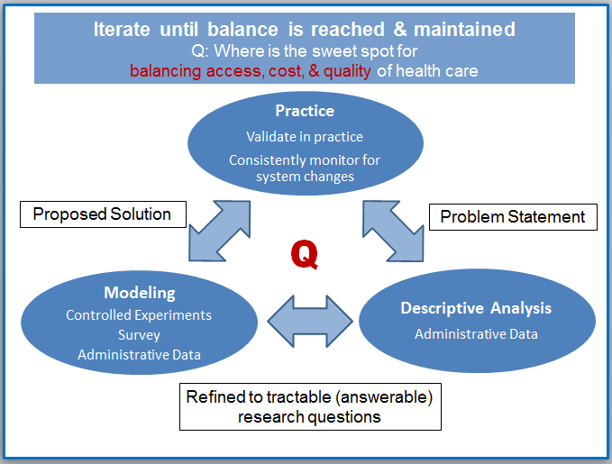
Learning Hospital
Integrating practice and research
A data-driven organization acquires, processes, and leverages data in a timely fashion to create efficiencies, iterate on and develop new products, services, and navigate the competitive landscape.

Slide 142
Hye-Chung Kum
PhD in computer science (data mining)
Minor: MSW (policy & management)
Primary appointment: HPM (17+ years: CS, SW, HPM)
Population Informatics Research Group
TAMU & UNC
Multidisciplinary: CS, HSR, SW, sociology
NSF Bigdata (cyberinfrastructure) DataBridge: A Sociometric System for Long-Tail Science Data Collections
TX HHSC: 1115 Medicaid Waiver Evaluation
NC DHHS: Management Assistance
NSF, google: Smart Diabetes Management
PCORI: Privacy Preserving Interactive Record Linkage (PPIRL)
Notes:
From computer science?
From social, health science?
Please feel free to interrupt anytime

Slide 143
Properties of BIG DATA : 4V
Volume : lots of data
Velocity : constantly generating & changing
Variety : expressed in many ways
Veracity : lots of errors
(Value)
EXAMPLE: the INTERNET!
What do you do to find information/knowledge on the Internet?

Slide 144
Finding actionable information on the Internet
Figure out your question (refine as you find out more)
Descriptive: what is X?
Hypothesis: Does X do Y?
Ontology/Taxonomies: Knowledge representation about the world (synonyms, relationship between concepts)
Information integration
Triangulation / validation
Map: Zoom In / Zoom Out

Slide 145
Why not reap the benefits too ?
The ability to answer questions about human populations in near real time using distributed datasets that are large, complex, and diverse has the potential to transform social, behavioral, economic, and health sciences (SBEH).
The results could lead to more informed and effective policy decisions and allocations of public resources.
What is the long term impact of moving to managed care ?
What effect does teacher pay in middle school have on college grades?
The answers could easily be derived from relevant data sets
HOW?
Population Informatics
Notes:
Isn’t it time we reap the benefits from big data as well?
The ability to answer questions about human populations in near real time using distributed datasets that are large, complex, and diverse has the potential to transform social, behavioral, economic, and health sciences.
The results could lead to more informed and effective policy decisions and allocations of public resources.
We can easily derive the answer to questions like ‘What is the long term impact of headstart?’ or What effect does teacher pay in middle school have on college grades?
from relevant datasets.
But it has to be done in the right way.

Slide 146
Why not reap the benefits too ?
The ability to answer questions about human populations in near real time using distributed datasets that are large, complex, and diverse has the potential to transform social, behavioral, economic, and health sciences (SBEH).
The results could lead to more informed and effective policy decisions and allocations of public resources.
What is the long term impact of moving to managed care ?
What effect does teacher pay in middle school have on college grades?
The answers could easily be derived from relevant data sets
Notes:
Isn’t it time we reap the benefits from big data as well?
The ability to answer questions about human populations in near real time using distributed datasets that are large, complex, and diverse has the potential to transform social, behavioral, economic, and health sciences.
The results could lead to more informed and effective policy decisions and allocations of public resources.
We can easily derive the answer to questions like ‘What is the long term impact of headstart?’ or What effect does teacher pay in middle school have on college grades?
from relevant datasets.
But it has to be done in the right way.

Slide 147
Why not reap the benefits too ?
The ability to answer questions about human populations in near real time using distributed datasets that are large, complex, and diverse has the potential to transform social, behavioral, economic, and health sciences (SBEH).
The results could lead to more informed and effective policy decisions and allocations of public resources.
What is the long term impact of moving to managed care ?
What effect does teacher pay in middle school have on college grades?
The answers could easily be derived from relevant data sets
Notes:
Isn’t it time we reap the benefits from big data as well?
The ability to answer questions about human populations in near real time using distributed datasets that are large, complex, and diverse has the potential to transform social, behavioral, economic, and health sciences.
The results could lead to more informed and effective policy decisions and allocations of public resources.
We can easily derive the answer to questions like ‘What is the long term impact of headstart?’ or What effect does teacher pay in middle school have on college grades?
from relevant datasets.
But it has to be done in the right way.

Slide 148
Why not reap the benefits too ?
The ability to answer questions about human populations in near real time using distributed datasets that are large, complex, and diverse has the potential to transform social, behavioral, economic, and health sciences (SBEH).
The results could lead to more informed and effective policy decisions and allocations of public resources.
What is the long term impact of moving to managed care ?
What effect does teacher pay in middle school have on college grades?
The answers could easily be derived from relevant data sets
Notes:
Isn’t it time we reap the benefits from big data as well?
The ability to answer questions about human populations in near real time using distributed datasets that are large, complex, and diverse has the potential to transform social, behavioral, economic, and health sciences.
The results could lead to more informed and effective policy decisions and allocations of public resources.
We can easily derive the answer to questions like ‘What is the long term impact of headstart?’ or What effect does teacher pay in middle school have on college grades?
from relevant datasets.
But it has to be done in the right way.

Slide 149
The Power of the Social Genome

Our activities from birth until death leave digital traces in large databases

Digital traces capture our social genome, the footprints of our society

The social genome data are massive and chaotic

It holds crucial insights into many of the most challenging problems facing our society (i.e. affordable and accessible quality healthcare, economics, education, employment, and welfare)
Notes:
Social scientists have long drawn on data collections from governments and elsewhere to track demographic trends such as inflation and employment rates. However, now in the digital era, our daily activities from birth until death leave digital crumbs all over cyberspace,
Collectively, these digital traces—across a group, town, county, state, or nation—form a population’s social genome, the collective footprints of our society.
and we have the technology to gather and analyze these crumbs to obtain crucial insights into the most challenging problems in society such as healthcare, economics, and education.

Slide 150
Is it new?
Computational social science
Population informatics
Simulations: agent based modeling, systems modeling
Data Science for Social Good (DSSG)
Population informatics
Social good projects not involving people: environment, animals
Population Informatics
Business analytics
Social computing: social network data analysis
Policy informatics
Computational journalism
Computational transportation
Computational Epidemiology
Population Data Science
Notes:
Google flu
model NY ferry boat route to preserve fish

Slide 151
New Era in Science : Big Data Science
Data is the new raw material of business: an economic input almost on par with capital and labor.(Microsoft’s Craig Mundie)
Those who can harness the power of data will lead the next century and drive innovation in commerce, scientific discovery, healthcare, finance, energy, government, and countless other fields.
Students who learn to be a data science will be in high demand.

Slide 152
AMPLab (Michael Franklin (UC Berkley): Integrating Three Key Resources
Algorithms
Machine Learning, Statistical Methods
Prediction, Business Intelligence
Machines
Clusters and Clouds
Warehouse Scale Computing
People
Crowdsourcing, Human Computation
Data Scientists, Analysts

Slide 153
NIH and Biomedical “Big Data” http://acd.od.nih.gov/Big-Data-to-Knowledge-Initiative.pdf

Slide 154
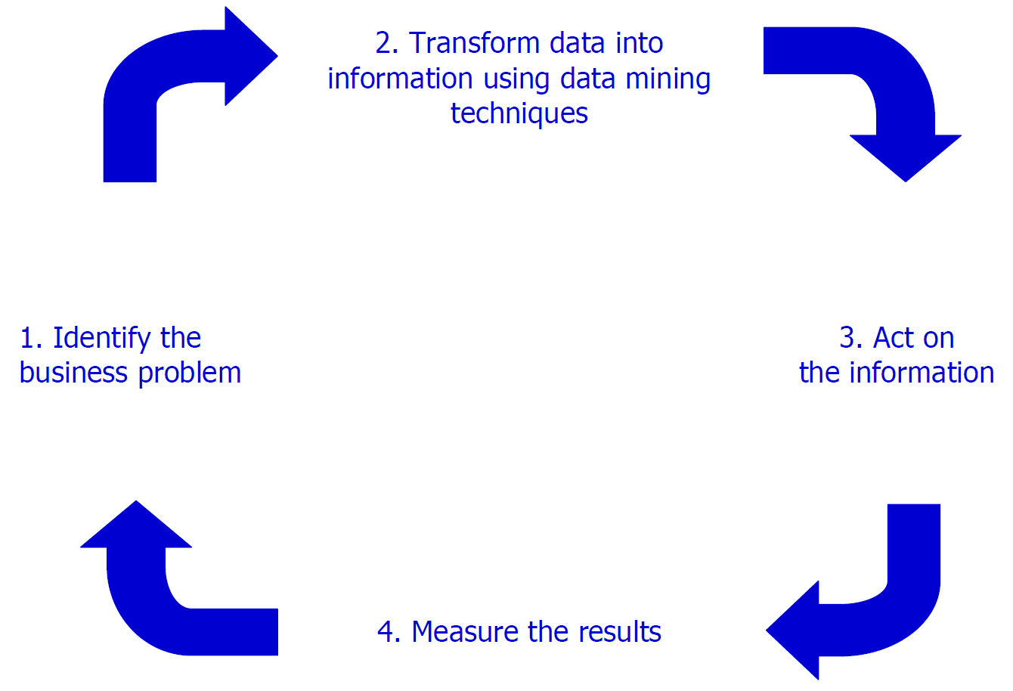
The Virtuous Cycle of Data to Decision & Action
Learning Health Systems
Notes:
Learning Health System

Slide 155
Agenda
Establish the field: Definitions
What is Data Science ?
What is Social Genome ?
What is Population Informatics ?
Challenges
Privacy
Data Access
Data Management
Data Integration & Cleaning
Error Management and Propagation

Slide 156
Primary Data
Big Data
Social Genome Data

Slide 157
Primary Methodology
Data Science (KDD)

Slide 158
Knowledge Discovery & Data mining (KDD) = Data Science
Big Data
KDD
Clean, Merge, Reprocess
Human consumable, valid, novel, potentially useful,
and ultimately understandable information
Fayyad, U. M. Piaetsky-Shapiro, G. Smyth, P. 1996. From Data Mining to Knowledge Discovery: An Overview. In, Advances in Knowledge Discovery and Data Mining. AAAI/MIT press, Cambridge Massachusetes.
Notes:
SIGKDD 1998: sexy word for KDD

Slide 159
What is data science ? Hye-Chung Kum
Measurement: Smart/clever counting of real things (meaning to people) in the digital data
Information generation: Then modeling using those measures (features)
Delivery of information: Storytelling with data
Develop agile data pipeline for timely processing that can be iteratively updated to track the dynamic ever changing real world

Slide 161
Decoupled Data : Identity disclosure w/o attribute disclosure

Slide 162
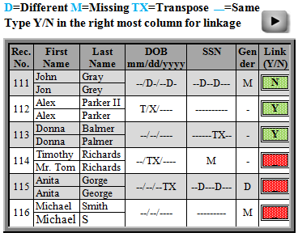

Slide 163
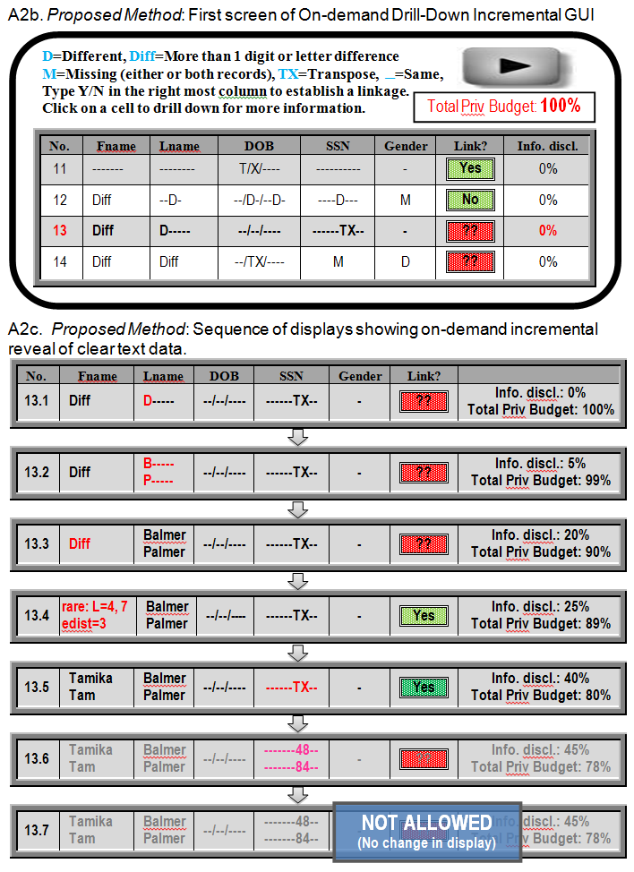
Incremental disclosure
Click on Red
Discloses more information incrementally

